Slide 1

IBM Data Science Capstone Project
SpaceX Falcon 9 Landing Prediction
A comprehensive machine learning analysis to forecast booster landing success and optimize mission planning.

Slide 2

Project Overview
This capstone project tackles one of the most critical challenges in modern spaceflight economics: predicting the success of SpaceX Falcon 9 first-stage booster landings. By successfully recovering and reusing boosters, SpaceX has revolutionized launch economics, reducing costs by up to 30% compared to expendable rockets.
Primary Goal
Predict landing success from mission parameters
Our analysis leverages comprehensive mission data to build predictive models that determine landing outcomes based on pre-flight parameters. This capability has significant implications for mission planning, risk assessment, and competitive cost analysis in the commercial space industry.
Tech Stack
Python, Pandas, NumPy, Scikit-Learn, Matplotlib, Seaborn, Jupyter

Slide 3

Project Objectives
01
02
03
Comprehensive Data Analysis
Predictive Model Development
Business Intelligence Extraction
Examine historical Falcon 9 launch records to identify patterns, correlations, and key factors that influence landing outcomes across different mission profiles and environmental conditions.
Design, train, and validate multiple machine learning algorithms to achieve robust prediction capabilities, comparing performance metrics to select optimal approaches for deployment scenarios.
Translate model insights into actionable recommendations for cost optimization, risk mitigation, and mission planning, quantifying potential savings and reliability improvements for stakeholders.

Slide 4

Dataset & Processing Pipeline
Data Acquisition
Feature Engineering
Mission data was systematically collected through two complementary approaches: direct extraction from the SpaceX REST API for structured telemetry and web scraping techniques for supplementary launch records. This dual-source strategy ensured comprehensive coverage of the Falcon 9 mission history.
Data Cleaning
Handled missing values, standardized formats, removed duplicates and outliers
EDA Insights
Visualized distributions, correlations, temporal trends
Key Variables
Payload Mass, Launch Site, Orbit Type, Booster Version, Flight Number, Grid Fins, Reused Count

Slide 5

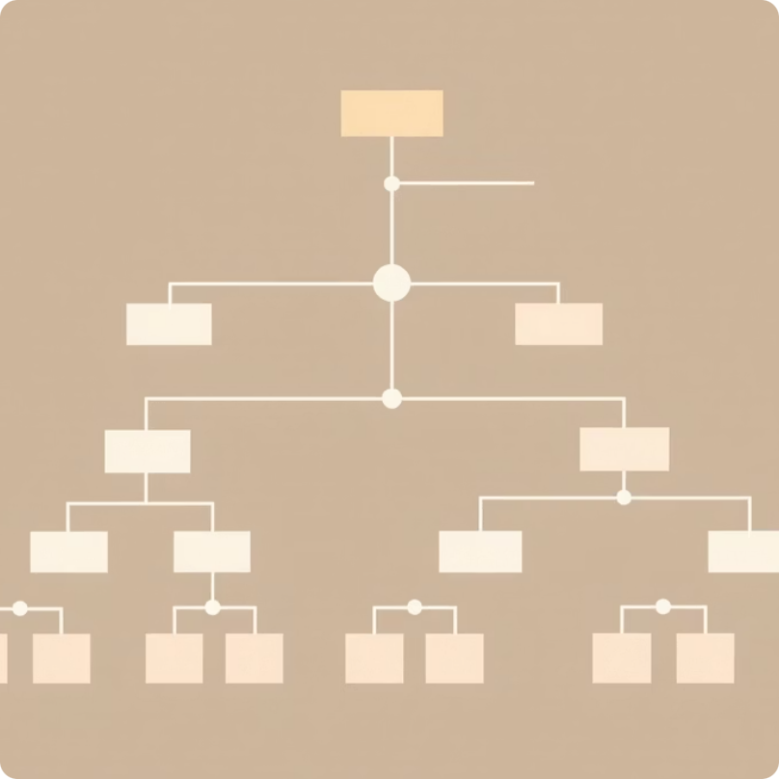


Machine Learning Model Suite
We implemented a diverse ensemble of classification algorithms to capture different aspects of the landing prediction problem. Each model brings unique strengths in handling the complex, multi-dimensional feature space of aerospace mission data.
Logistic Regression
Decision Tree
K-Nearest Neighbors
Support Vector Machine
Baseline linear classifier providing interpretable coefficients and probability estimates for landing success.
Non-linear model capturing complex feature interactions through hierarchical decision rules.
Instance-based learning leveraging similarity metrics across the feature space for local predictions.
Kernel-based classifier optimizing margin separation for robust generalization on test data.

Slide 6

Model Performance Summary
87%
Critical Success Factors
Feature importance analysis revealed three dominant predictors that consistently drove landing outcomes across all model architectures. These variables emerged as the primary levers for mission planning optimization.
Peak Accuracy
Best model performance on test dataset
1
Booster Version
2
Payload Mass
Block 5 boosters demonstrated significantly higher landing success rates due to enhanced control systems and structural reinforcements.
Heavier payloads correlated with reduced landing probability, reflecting fuel budget constraints for deceleration maneuvers.
0.91
F1 Score
3
Launch Site
Balanced precision-recall metric
Geographic location influenced success through proximity to recovery zones and prevailing atmospheric conditions.

Slide 7

Strategic Recommendations
Payload Optimization
Fleet Prioritization
Establish payload mass thresholds for high-confidence landing predictions. Consider splitting heavy payloads across multiple launches to maximize recovery probability and lifecycle cost efficiency.
Preferentially allocate Block 5 and newer booster versions to missions where recovery is critical. Retire older variants to expendable trajectories for maximum value extraction.
Data Enhancement
Expand telemetry collection to include atmospheric conditions, real-time trajectory deviations, and subsystem health metrics for next-generation model refinement and accuracy gains.
Implementation of these data-driven insights can further reduce launch costs, increase mission reliability, and strengthen competitive positioning in the commercial space market.

